Slide 1
Quantum linear solvers for fluid dynamics
WCISCC 2025 ORNL
Murali Gopalakrishnan Meena
OLCF, Oak Ridge National Laboratory
This research used resources of the Oak Ridge Leadership Computing Facility (OLCF) at the Oak Ridge National Laboratory, which is supported by the Office of Science of the U.S. Department of Energy under Contract No. DE-AC05-00OR22725.

Slide 2
Introduction & Motivation
Fluid dynamics & Linear system of equations

Slide 3
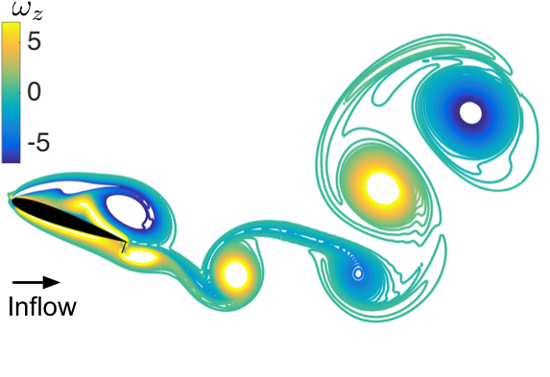
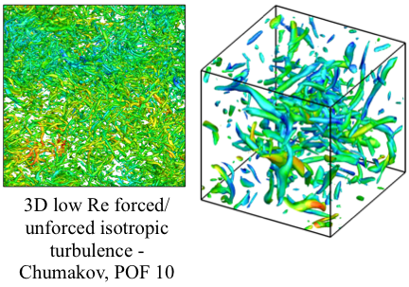
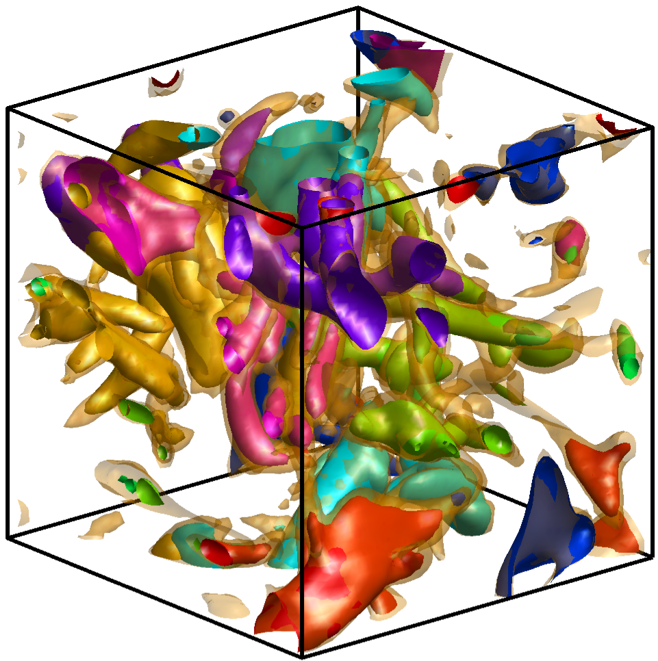
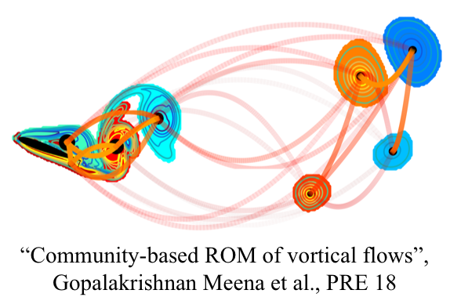
Fluid dynamics is everywhere & its “pretty” turbulent
Reduce-order modeling of laminar flow over an airfoil^{[1]}
Community structures in 3D isotropic turbulence^{[2]}
[1] Gopalakrishnan Meena, et al., PRE, 2018
[2] Gopalakrishnan Meena & Taira, J. Fluid Mech., 2021

Slide 4
Governing equations of fluid flow comprise of linear & nonlinear terms that can be solved numerically
Conservation of mass
The Navier—Stokes Equations
Conservation of momentum
Pressure Poisson equation

Slide 5






Governing equations are discretized to create a set of algebraic equations & assembled into $Ax=b$
Linear Solver
$$×$$
$$=$$
$$A$$
$$x$$
$$b$$

Slide 6
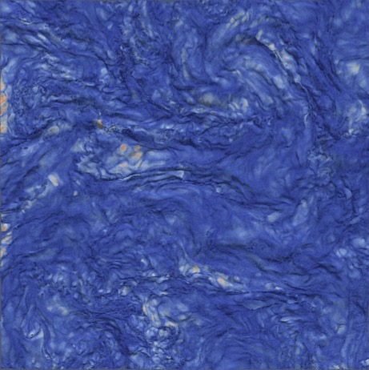
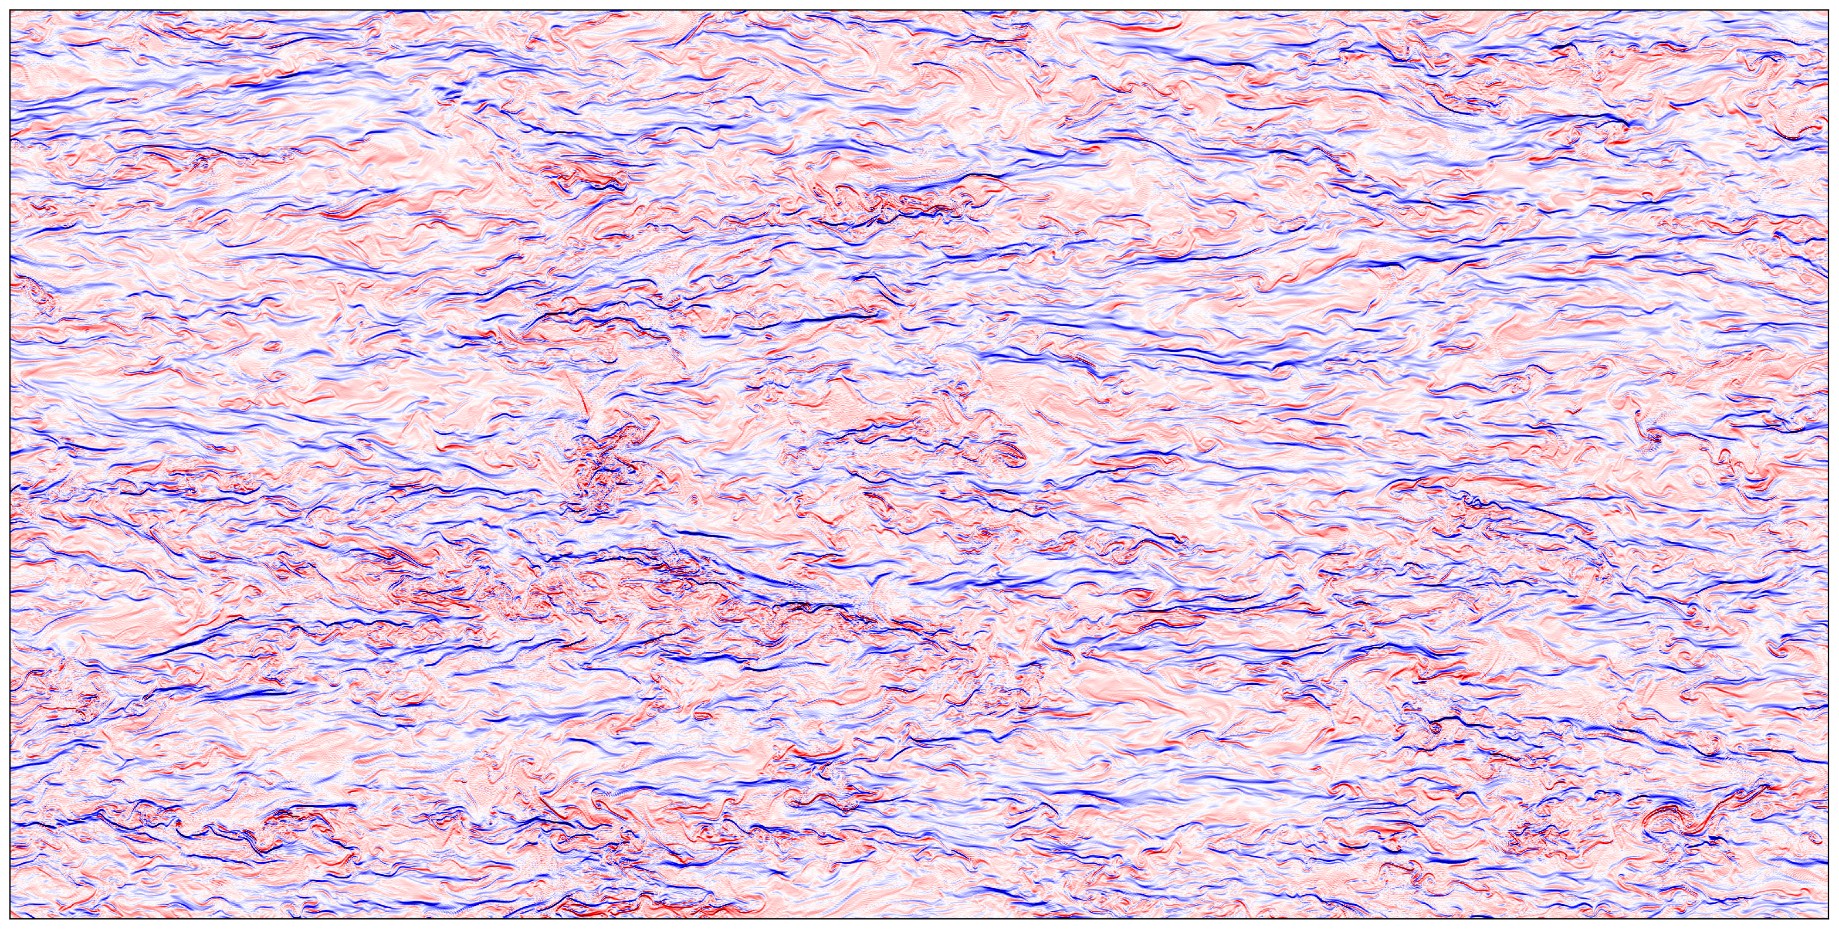
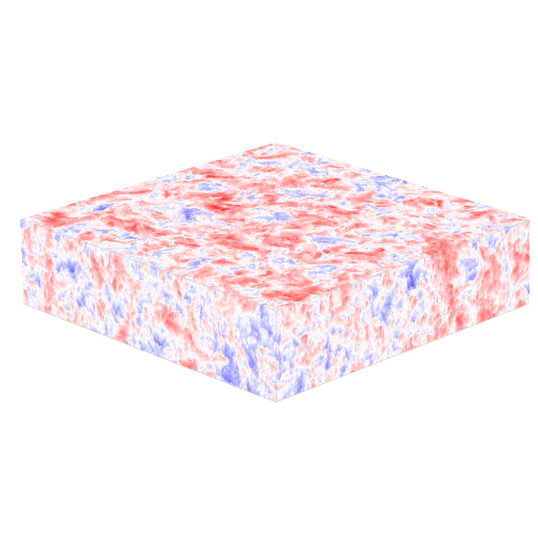

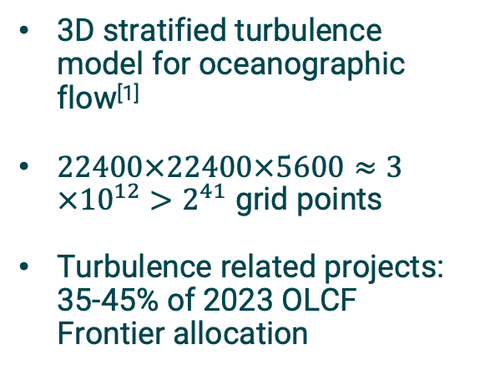
Grid resolution can get prohibitively expensive to simulate for practical fluid flow problems
3D stratified turbulence model for oceanographic flow^{[1]}
$22400×22400×5600≈3×{10}^{12}>2^{41}$ grid points
Turbulence related projects: 35-45% of 2023 OLCF Frontier allocation
Contour plot of the perturbed vertical density gradient for 1/4th of the domain.
Contour plots of the perturbed density after subsampling the domain.
[1] J. J. Riley, et al., J. Turbulence, 2023
Isosurface of scalar dissipation rate for 1/25th of the domain, constructed using $127×{10}^{6}$ triangles.

Slide 7
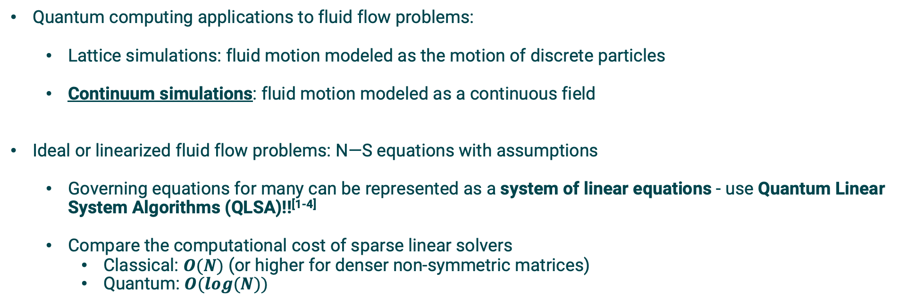
Quantum linear solvers have the potential to exponentially reduce cost of solving large problems
Quantum computing applications to fluid flow problems:
Lattice simulations: fluid motion modeled as the motion of discrete particles
Continuum simulations: fluid motion modeled as a continuous field
Ideal or linearized fluid flow problems: N—S equations with assumptions
Governing equations for many can be represented as a system of linear equations - use Quantum Linear System Algorithms (QLSA)!!^{[1-4]}
Compare the computational cost of sparse linear solvers
Classical: $O(N)$ (or higher for denser non-symmetric matrices)
Quantum: $O(log⁡(N))$
[1] Yepez, PRE, 2001
[2] Xu, Daley, Givi, Somma, AIAAJ, 2018
[3] Bharadwaj & Sreenivasan, PNAS, 2023
[4] Gopalakrishnan Meena at al., PoF, 2024
Notes:
Ideal flow – forms basis for modeling many real world flow problems (some have direct practical implications)

Slide 8
Objectives of this presentation
Disclaimer: We are not trying to show/demonstrate quantum advantage for fluid flow problems
Current talk objectives:
Preliminary efforts at OLCF to investigate the application of QLSA on canonical fluid flow problems^{[1]}
Practical issues on using the algorithms for canonical fluid flow problems
Accuracy
Computational cost
Noise modeling & mitigation
Running on real hardware
[1] Gopalakrishnan Meena at al., PoF, 2024

Slide 9
Quantum Computing
A very brief Intro to QC

Slide 10
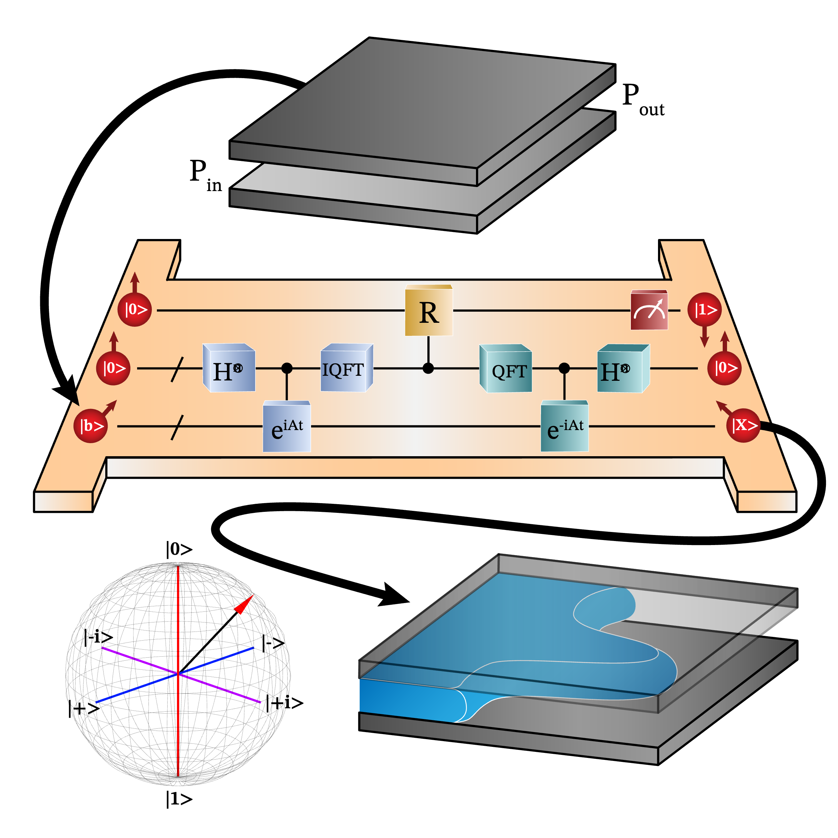
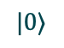
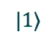

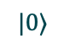
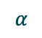

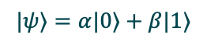

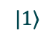
Classical vs Quantum Computing
Bit vs Qubit – information states
State of superposition – a combination of all possible configurations
Store more information!
Measuring will lead to collapse to a binary state
Types of qubits:
Superconducting
Trapped ion
Photons
Neutral atoms
Quantum dots
Classical computing - Bit
Quantum computing - Qubit
$$0$$
$$|0⟩$$
$$α$$
$$β$$
Quasi-probabilities
$$1$$
$$|1⟩$$
$$|0⟩$$
$$|1⟩$$
$$|ψ⟩=α|0⟩+β|1⟩$$
https://www.ibm.com/think/topics/quantum-computing
Notes:
Perform calculations exponentially faster w.r.t the input size
Simulations in chemistry & materials, cryptography, search, ML

Slide 11

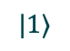
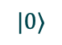
Key principles of quantum computing
$$|0⟩$$
$$|1⟩$$
Superposition
Entanglement – ability of qubits to correlate with each others’ states
Store even more information!
Interference – information is structured like waves with amplitudes
Waves can amplify or cancel each other
Amplitudes: Probabilities of the outcomes of measurement
Decoherence – collapse from quantum to nonquantum state
Intentionally (measurement)
Allows quantum computers to interact with classical computers
Unintentionally (interaction with environment)
$$+$$
$$|ψ⟩=α_{1}|00⟩+α_{2}|01⟩+α_{3}|10⟩+α_{4}|11⟩$$
$$α$$
$$β$$
Quasi-probabilities
$$|0⟩$$
$$|1⟩$$
Classical Bit
Qubit

Slide 12
Working of a quantum computer
Qubits are prepared as superposition of states
Gates used to operate on qubits and entangle them
Unitary operations
Reversible
Can operate on a single qubit or multiple (entanglement)
Circuits are collection of gates
Quantum algorithms are collection of circuits to create desired interference between states
Measurement (amplified outcomes) gives solution
Phase Estimation
Inverse Phase Estimation

Slide 13
Running a quantum algorithm
Backend | Mechanism | Functionality
Simulator | Classical | Classical program modeling a quantum system in an ideal scenario
Emulator | Classical | Classical program modeling actual behavior of a quantum system
Real | Quantum | Physical hardware performing real quantum computations

Slide 14
QLSA + Fluid Dynamics
Solving the Hele—Shaw flow using QLSA

Slide 15
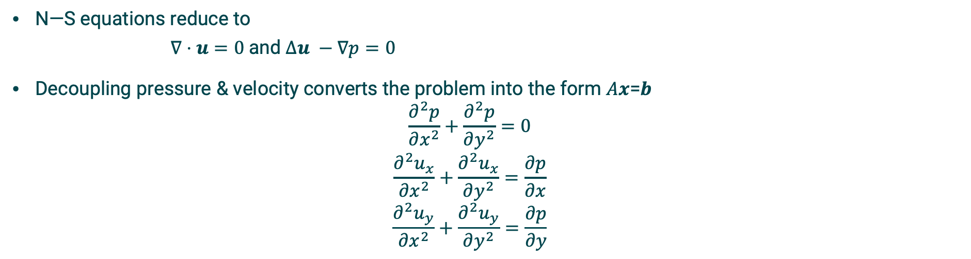
Model problem: Hele—Shaw flow
Flow between 2 flat plates driven by pressure difference at inlet & outlet
Flow properties:
2D, Steady
Incompressible, inviscid
N—S equations reduce to
$∇⋅u=0$and $Δu −∇p=0$
Decoupling pressure & velocity converts the problem into the form 𝐴𝒙=𝒃
$$\frac{∂^{2}p}{∂x^{2}}+\frac{∂^{2}p}{∂y^{2}}=0$$
$$\frac{∂^{2}u_{x}}{∂x^{2}}+\frac{∂^{2}u_{x}}{∂y^{2}}=\frac{∂p}{∂x}$$
$$\frac{∂^{2}u_{y}}{∂x^{2}}+\frac{∂^{2}u_{y}}{∂y^{2}}=\frac{∂p}{∂y}$$

Slide 16
Overview of solving the Hele—Shaw flow using a QLSA

Slide 17
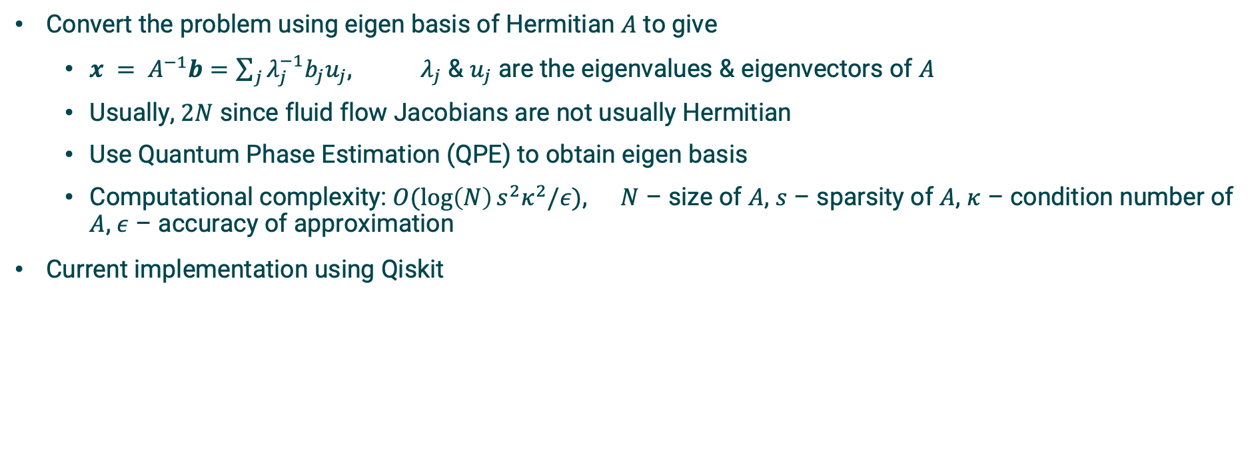
The Harrow–Hassidim–Lloyd (HHL) algorithm
Convert the problem using eigen basis of Hermitian $A$ to give
$x = A^{−1}b=\sum_{j}{λ_{j}^{−1}b_{j}u_{j}}$, $λ_{j}$ & $u_{j}$ are the eigenvalues & eigenvectors of $A$
Usually, $2N$ since fluid flow Jacobians are not usually Hermitian
Use Quantum Phase Estimation (QPE) to obtain eigen basis
Computational complexity: $O(\log\left(N\right)s^{2}κ^{2}/ε)$, $N$ – size of $A$, $s$ – sparsity of $A$, $κ$ – condition number of $A$, $ε$ – accuracy of approximation
Current implementation using Qiskit
Harrow, Hassidim, and Lloyd, PRL, 2009
Zaman et al., IEEE Access, 2023

Slide 18
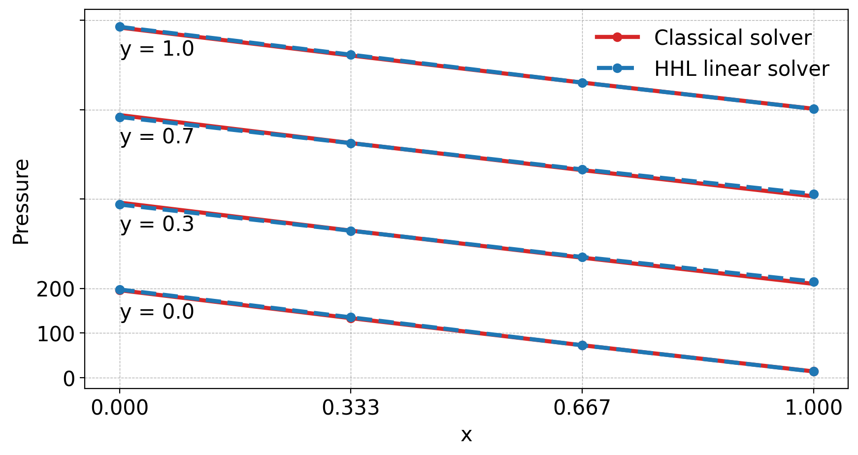
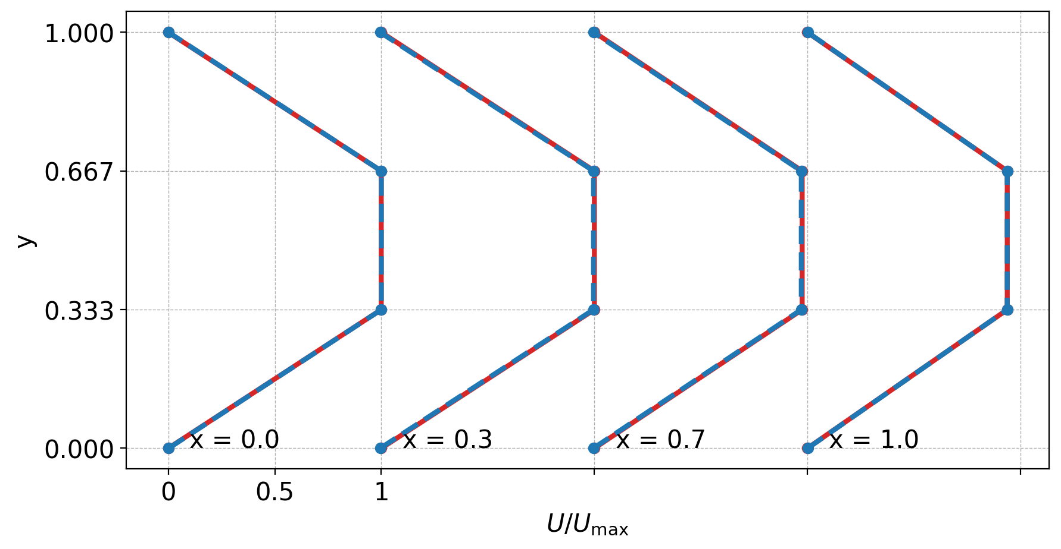
Results: Accurate reconstruction of the pressure & velocity profiles achieved using simulators
Results using classical simulators
Variable | Pressure | Velocity
Fidelity (%) | 99.9 | 99.9

Slide 19
Results: Computational costs are quite high attributing to condition number of system
Testing a sample system of linear equations: tridiagonal Toeplitz matrix
Need for GPU accelerated simulators: cuQuantum
Preconditioning matrix or preconditioning-free HHL algorithm
Better QPE algorithm

Slide 20
Results: Noise modeling, error mitigation & suppression better enable running on real hardware
Noise modeling & mitigation using Qiskit primitives: Sampler
Noise model: fake backends
Error mitigation: qubit readout errors
Error suppression: Optimizing circuit and Dynamic decoupling
* Gopalakrishnan Meena at al., PoF, 2024

Slide 21
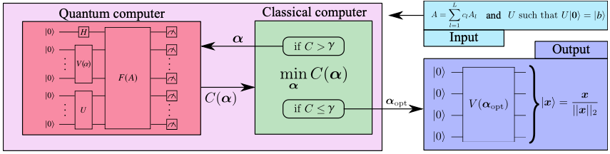
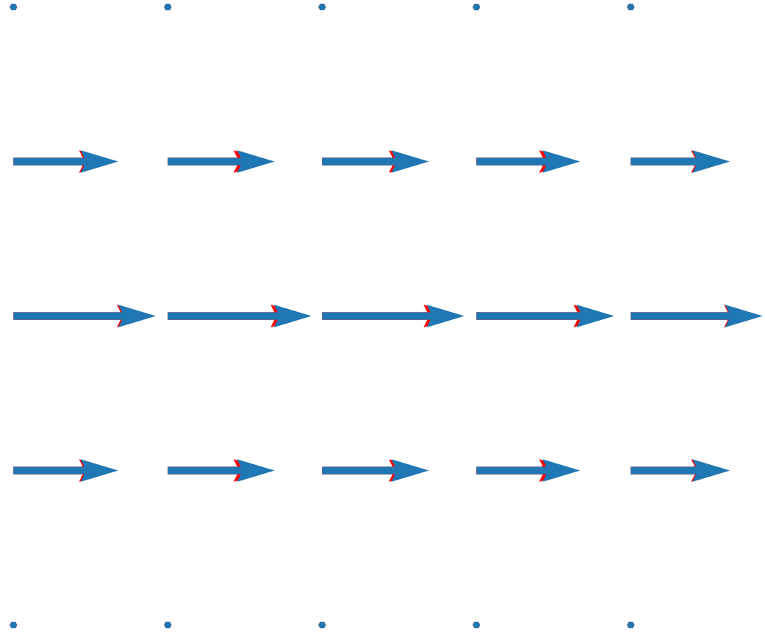
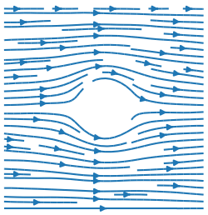
Future directions
Computational cost
Need for hybrid quantum-classical algorithms^{[1,2,3]}: Variational Quantum Linear Solvers
Enhanced QPE algorithm
Error modeling & mitigation for real hardware
Better/additional noise model
Other mitigation strategies (relevance of Estimator)
Different hardware (eliminating swap gates) – trapped ion (Quantinuum, IonQ)
Tackle more complex flow problems
2D potential flow over a cylinder/sphere
[1] Bravo-Prieto et al, 2020
[2] Jaksch et al, AIAAJ 2023
[3] Bharadwaj & Sreenivasan, 2023

Slide 22



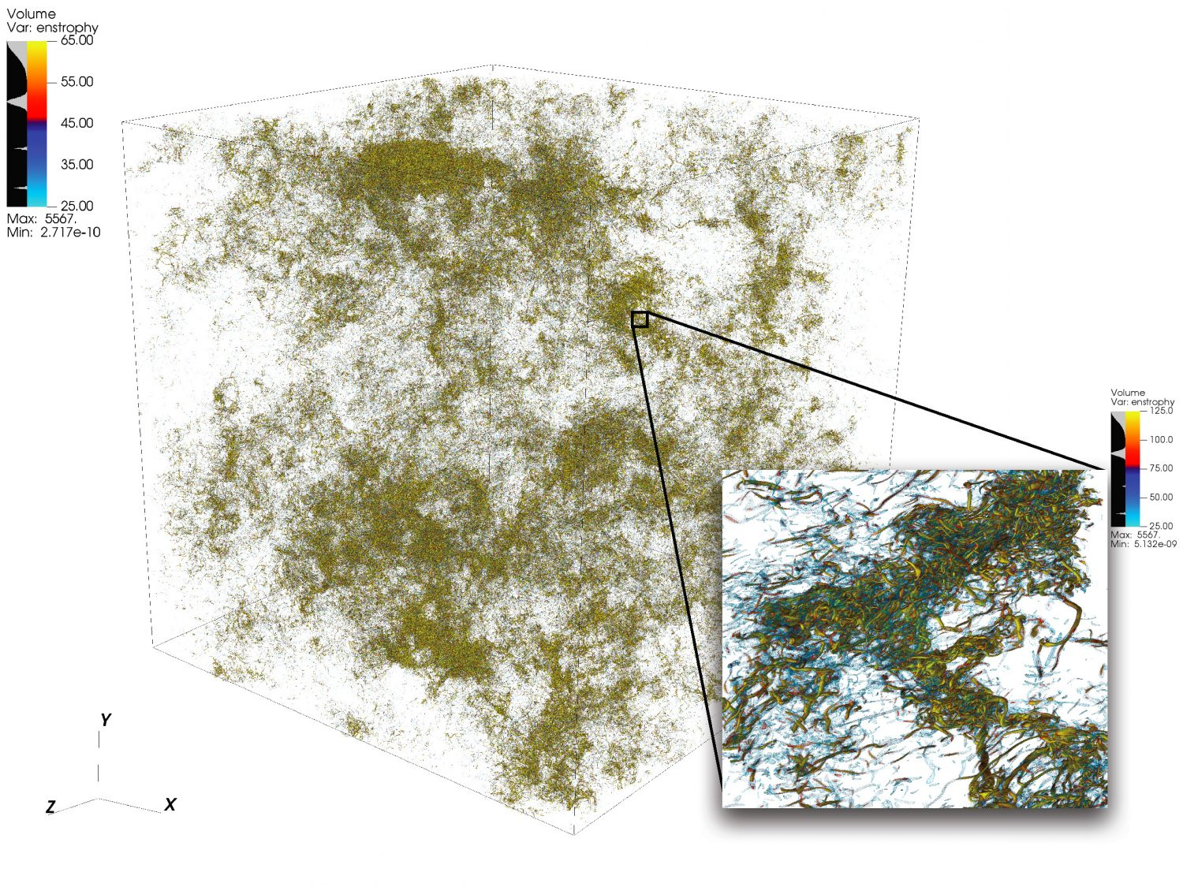
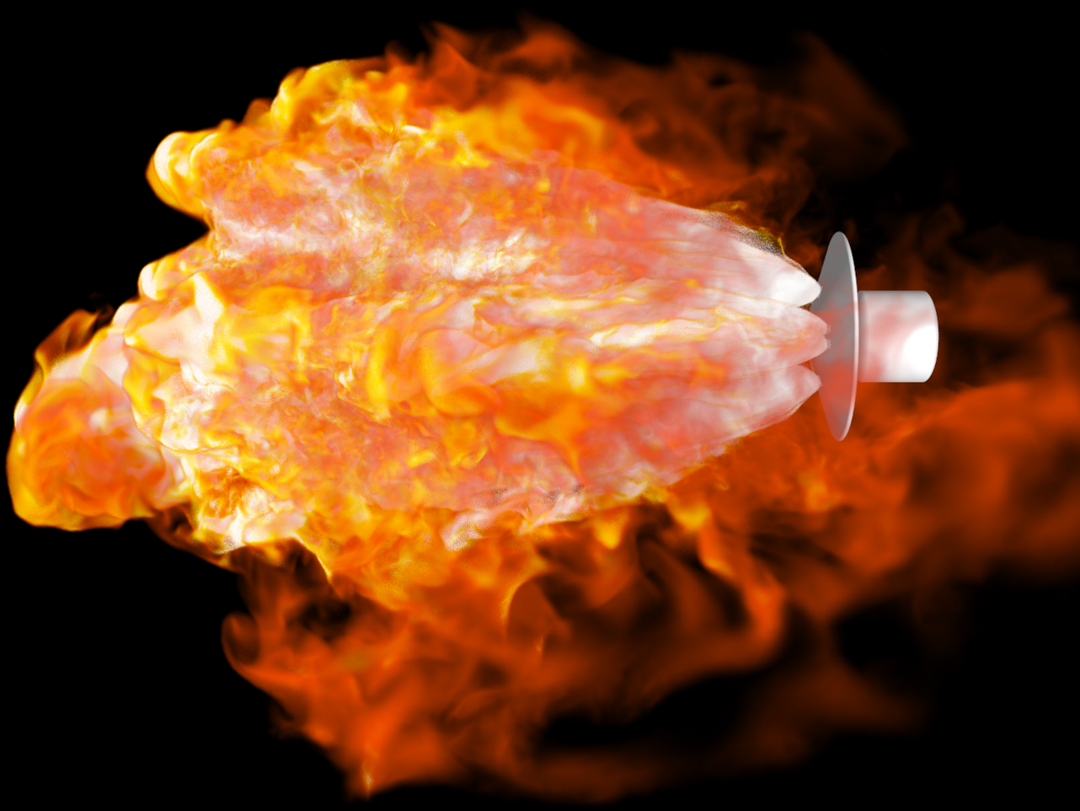
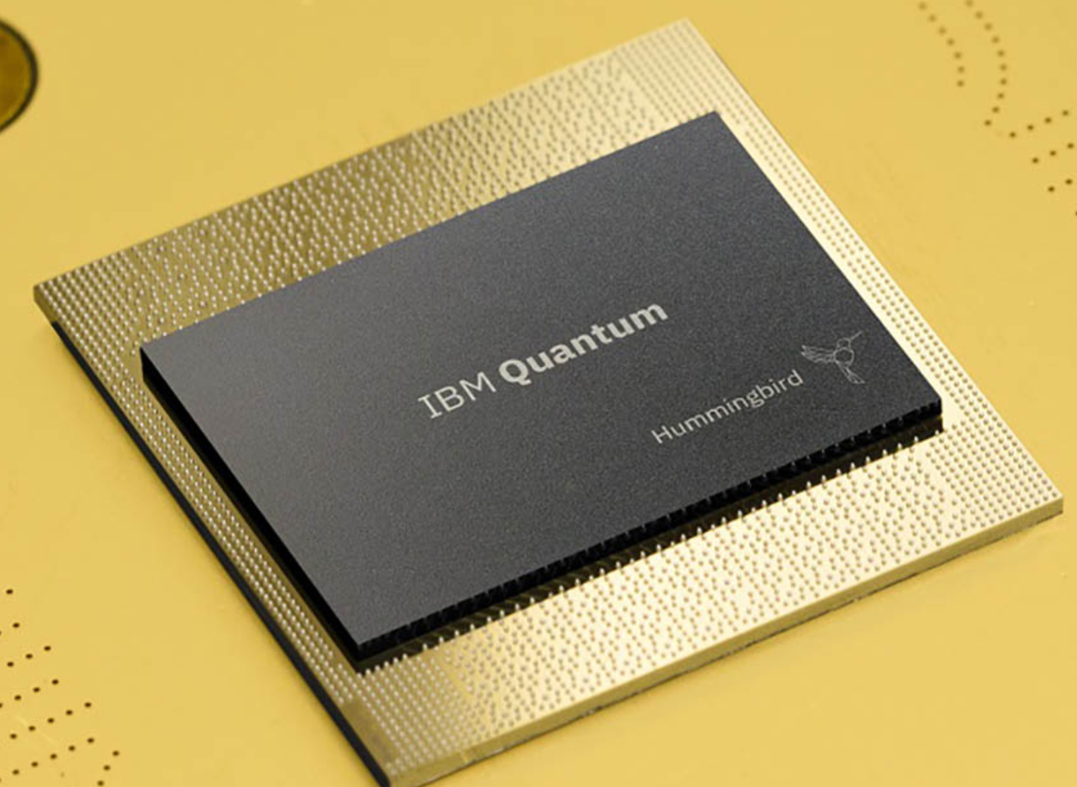

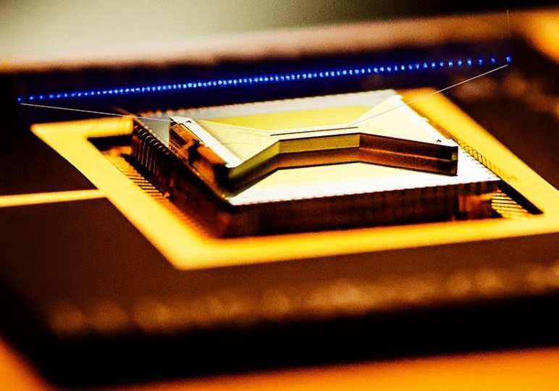





Computational resource allocation at Oak Ridge Leadership Computing Facility (OLCF)
Quantum Computing User Program (QCUP)
Large allocations: INCITE & ALCC
Call for proposals: Once per year
Small allocations: DD
Call for proposals: At any time
Frontier: World’s 1st exascale supercomputer
Premium access to current stack of quantum devices available through OLCF
Apply any time
Each project is assigned a liaison:
ORNL point of contact with quantum science expertise
Access available for international (non-US) participants
Link
Link
Contact – gopalakrishm@ornl.gov

